Slide 1
Introduction to Multiplication

Slide 2
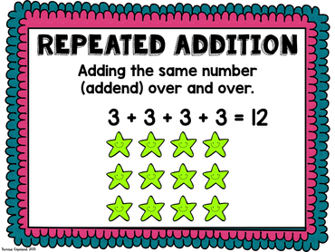
Multiplication is actually just addition
3x4=

Slide 3
Show me Multiplication as addition...
4x6=
4+4+4+4+4+4 =
24
8
8
8
+

Slide 4
Multiplication is actually skip counting!
8
12
16
20
24
4x6=
4+4+4+4+4+4 =
24

Slide 5
Show me Multiplication as skip counting!
10
15
20
25
30
35
5x7=
5+5+5+5+5+5+5 =
35

Slide 6
What strategy works for you?
Try these…
2x6
4X9
3x3

